Slide 1
Polymerase Chain Reaction

Slide 2
PCR
PCR Polymerase chain reaction (PCR) is a technique used in molecular biology to amplify a single copy or a few copies of a segment of DNA across several orders of magnitude, generating thousands to millions of copies of a particular DNA sequence.
Developed in 1983 by Kary Mullis, PCR is now a common technique used in clinical and research laboratories for a broad variety of applications.
In 1993, Mullis was awarded the Nobel Prize in Chemistry for his work on PCR.

Slide 3
Principle
The purpose of PCR is to enzymaticaly synthesizing and amplifying defined DNA sequences ( make a huge number of copies of a gene)
A PCR reaction include the target DNA , a thermostable DNA polymerase , 2 oligonucleotide primers, deoxynucleotide triphosphates (dNTPs),reaction buffer and magnesium.
The component are mixed the reaction is placed in the thermal cycler.
The thermal cycler takes the reaction through a serious of different temperatures for varying a mounts of time.
This serious of temperatures and time adjustments is referred to as one cycle of amplification.

Slide 4
Procedure/Steps of PCR
There are three main stages:
  Denaturing – when the double-stranded template DNA is heated to separate it into two single strands.
  Annealing – when the temperature is lowered to enable the DNA primers to attach to the template DNA.
  Extending – when the temperature is raised and the new strand of DNA is made by the Taq polymerase enzyme.
These three stages are repeated 20-40 times, doubling the number of DNA copies each time.
A complete PCR reaction can be performed in a few hours, or even less than an hour with certain high-speed machines.
After PCR has been completed, a method called electrophoresis can be used to check the quantity and size of the DNA fragments produced.

Slide 5
Denaturing stage
During this stage the cocktail containing the template DNA and all the other core ingredients is heated to 94-95⁰C.
The high temperature causes the hydrogen bonds? between the bases in two strands of template DNA to break and the two strands to separate.
This results in two single strands of DNA, which will act as templates for the production of the new strands of DNA.
It is important that the temperature is maintained at this stage for long enough to ensure that the DNA strands have separated completely.
This usually takes between 15-30 seconds.

Slide 6
Annealing stage
During this stage the reaction is cooled to 50-65⁰C. This enables the primers to attach to a specific location on the single-stranded template DNA by way of hydrogen bonding (the exact temperature depends on the melting temperature of the primers you are using).
Primers are single strands of DNA or RNA? sequence that are around 20 to 30 bases in length.
The primers are designed to be complementary? in sequence to short sections of DNA on each end of the sequence to be copied.
Primers serve as the starting point for DNA synthesis. The polymerase enzyme can only add DNA bases to a double strand of DNA. Only once the primer has bound can the polymerase enzyme attach and start making the new complementary strand of DNA from the loose DNA bases.
The two separated strands of DNA are complementary and run in opposite directions (from one end - the 5’ end – to the other - the 3’ end); as a result, there are two primers – a forward primer and a reverse primer.
This step usually takes about 10-30 seconds.

Slide 7
Extending stage
During this final step, the heat is increased to 72⁰C to enable the new DNA to be made by a special Taq DNA polymerase enzyme which adds DNA bases.
Taq DNA polymerase is an enzyme taken from the heat-loving bacteria? Thermus aquaticus.
  This bacteria normally lives in hot springs so can tolerate temperatures above 80⁰C.
  The bacteria's DNA polymerase is very stable at high temperatures, which means it can withstand the temperatures needed to break the strands of DNA apart in the denaturing stage of PCR.
  DNA polymerase from most other organisms would not be able to withstand these high temperatures, for example, human polymerase works ideally at 37˚C (body temperature).
72⁰C is the optimum temperature for the Taq polymerase to build the complementary strand. It attaches to the primer and then adds DNA bases to the single strand one-by-one in the 5’ to 3’ direction.
The result is a brand new strand of DNA and a double-stranded molecule of DNA.
The duration of this step depends on the length of DNA sequence being amplified but usually takes around one minute to copy 1,000 DNA bases (1Kb).
These three processes of thermal cycling are repeated 20-40 times to produce lots of copies of the DNA sequence of interest.
The new fragments of DNA that are made during PCR also serve as templates to which the DNA polymerase enzyme can attach and start making DNA.
The result is a huge number of copies of the specific DNA segment produced in a relatively short period of time.

Slide 8
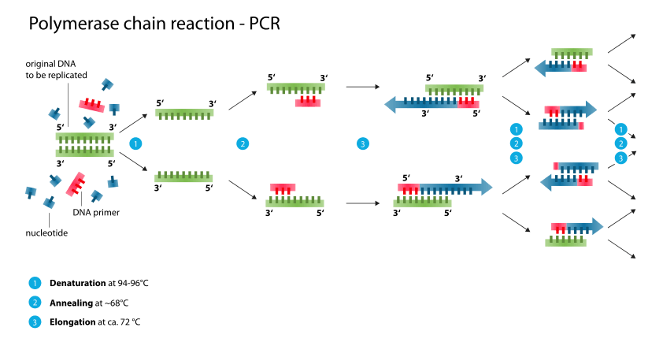

Slide 9
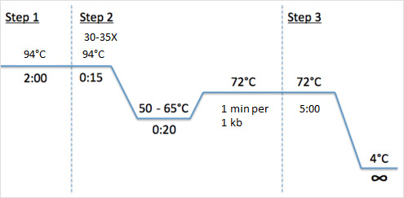

Slide 10
PCR Cocktail
Components | 20µl(quantity of single tube)
10 x buffer | 1.5 µl
dNTP MIX | 1.0 µl
MgCl2 | 0.5 µl
Primer | 0.5 µl
Taq polymerase | 1.0 µl
DDH2O | 13.5 µl
20 µl of above mixture was added to 1 µl of diluted DNA and was used for amplification process.

Slide 11
Step | Temp | Time | # of cycles
Initial Denaturation | 94°C | 5 min
Denaturation | 94°C | 30 sec | 30-35
Primer Annealing | T_{m}-5°C | 45 sec
Extension | 72°C | 1 min per kb
Final Extension | 72°C | 5 min

Slide 12
GeNei One Step RT PCR Kits
Product | Qty | Cat. | Pl. | Price (Rs.)
GeNei One Step AMV RT-PCR kit (5 reactions) | 1 Pack | 107551 | KT116S | 3300
GeNei One Step AMP RT-PCR KIT (25 reactions) | 1 Pack | 107552 | KT116M | 13000
GeNei One Step AMP RT-PCR KIT (25 reactions) | 1 Pack | 107553 | KT116L | 36250
GeNei One Step AMP RT-PCR KIT (25 reactions) | 1 Pack | 107554 | KT117S | 2500
GeNei One Step AMP RT-PCR KIT (25 reactions) | 1 Pack | 107555 | KT117M | 10100
GeNei One Step AMP RT-PCR KIT (25 reactions) | 1 Pack | 107556 | KT117L | 29350

Slide 13
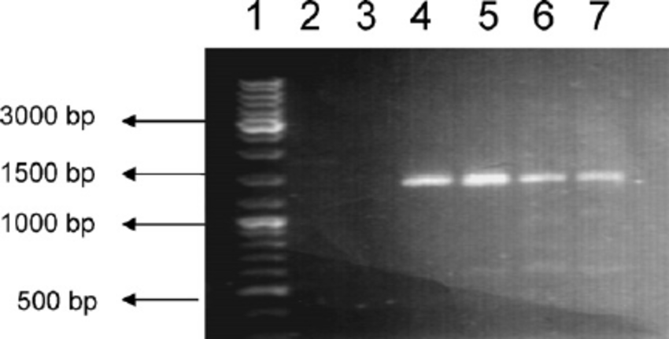

Slide 14
Application
PCR is used in analyzing clinical specimens for the presence of infectious agents, including HIV, hepatitis, malaria, anthrax, etc.
PCR can provide information on a patient’s prognosis, and predict response or resistance to therapy. Many cancers are characterized by small mutations in certain genes, and this is what PCR is employed to identify.
PCR is used in the analysis of mutations that occur in many genetic diseases (e.g. cystic fibrosis, sickle cell anaemia, phenylketonuria, muscular dystrophy).
PCR is also used in forensics laboratories and is especially useful because only a tiny amount of original DNA is required, for example, sufficient DNA can be obtained from a droplet of blood or a single hair.
PCR is an essential technique in cloning procedure which allows generation of large amounts of pure DNA from tiny amount of template strand and further study of a particular gene.
The Human Genome Project (HGP) for determining the sequence of the 3 billion base pairs in the human genome, relied heavily on PCR.
PCR has been used to identify and to explore relationships among species in the field of evolutionary biology. In anthropology, it is also used to understand the ancient human migration patterns. In archaeology, it has been used to spot the ancient human race. PCR commonly used by Paleontologists to amplify DNA from extinct species or cryopreserved fossils of millions years and thus can be further studied to elucidate on.

Slide 15
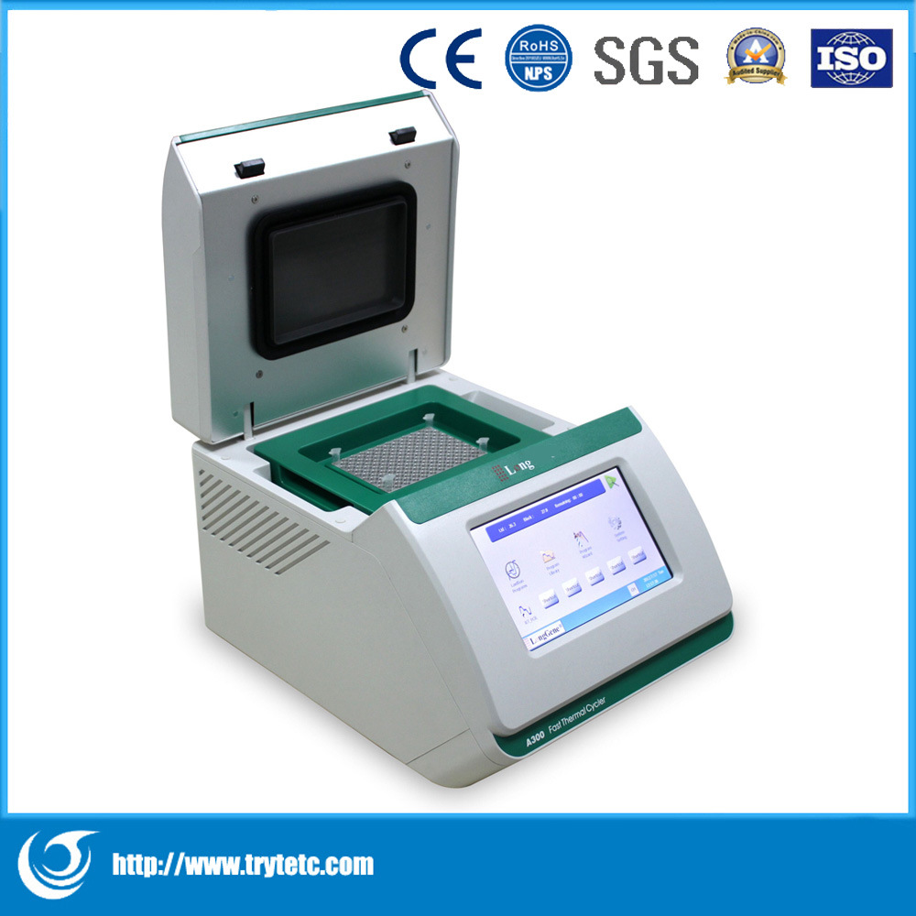

Slide 16
